Slide 1
Review of Math Concepts
Prof. P. Seshu
IIT Bombay
Prof. P. Seshu, Mech. Engg. Dept., IIT Bombay

Slide 2
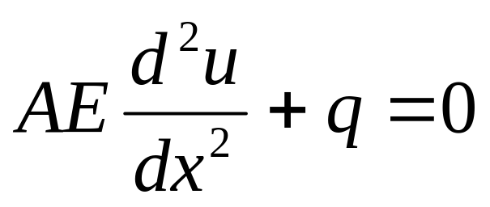
Differential Equations
Consider, for example, axial deformation of a rod
Assume geometry of deformation
Assume material behavior
Then use principle of equilibrium of forces to derive:
Prof. P. Seshu, Mech. Engg. Dept., IIT Bombay

Slide 3
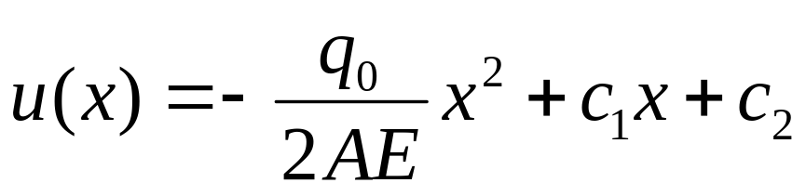
General solution is –
Differential equations admit a family of solutions; specific solution obtained by finding integration constants using boundary conditions and/or initial conditions
Prof. P. Seshu, Mech. Engg. Dept., IIT Bombay

Slide 4
The exact solution so obtained satisfies the differential equation at each and every interior point
It also satisfies ALL boundary/initial conditions
Numerical methods such as FEM, BEM can not guarantee this!!
Remember – the differential equation itself is approximate because of assumptions
Prof. P. Seshu, Mech. Engg. Dept., IIT Bombay

Slide 5
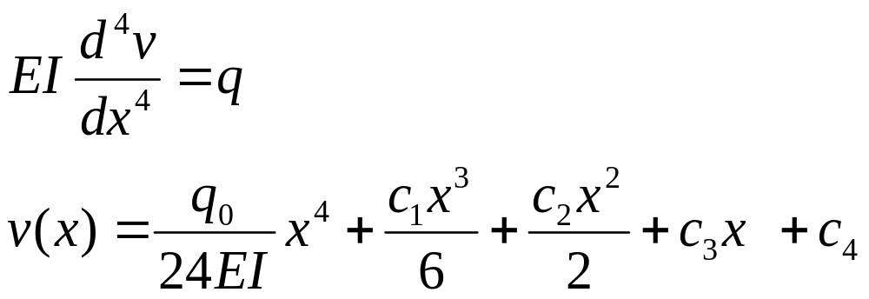
Euler – Bernoulli beam bending theory, based on several assumptions of geometry of deformation, stress-strain relation leads to the governing differential equation –
Prof. P. Seshu, Mech. Engg. Dept., IIT Bombay

Slide 6
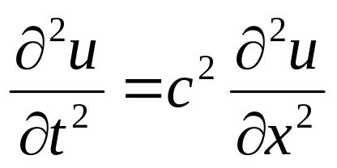
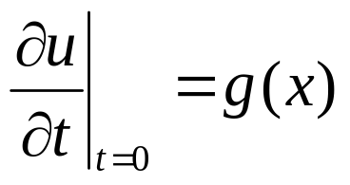
Consider one-dimensional wave equation –
U(x,t) is vibration of stretched elastic string
b.c. – u(0,t)=u(L,t)=0
i.c. – u(x,0)=f(x);
Prof. P. Seshu, Mech. Engg. Dept., IIT Bombay

Slide 7
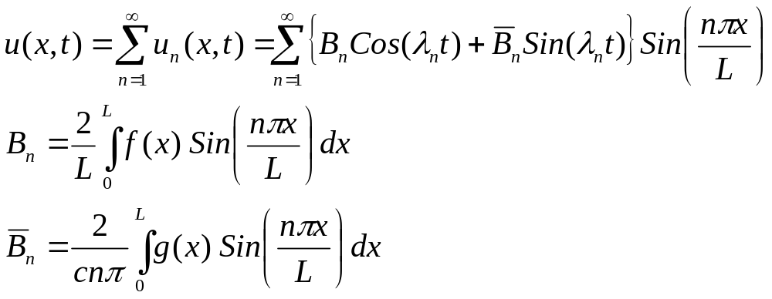
Prof. P. Seshu, Mech. Engg. Dept., IIT Bombay

Slide 8
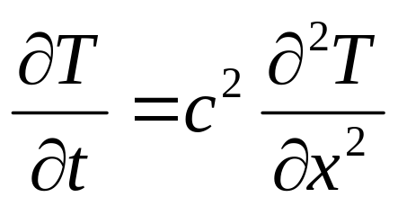
Consider one-dimensional heat equation –
T(x,t) is the temperature
b.c. – T(0,t)=T(L,t)=0
i.c. – T(x,0)=f(x);
Apparently minor difference in d.e. but solution behaves very differently
Prof. P. Seshu, Mech. Engg. Dept., IIT Bombay

Slide 9
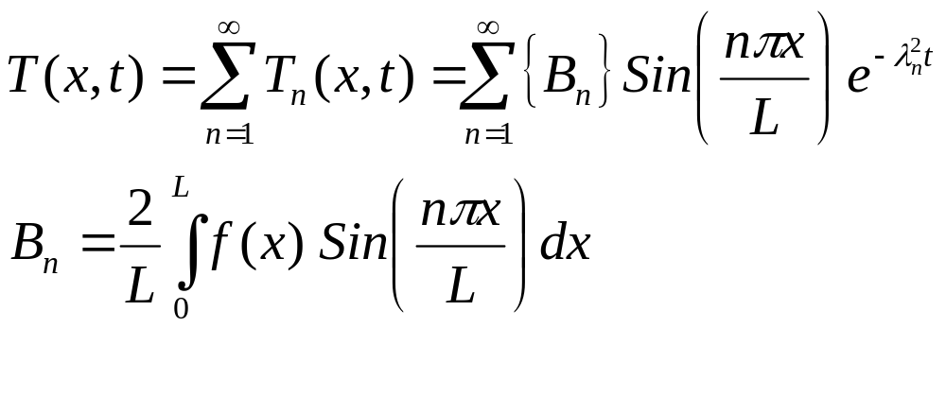
Prof. P. Seshu, Mech. Engg. Dept., IIT Bombay

Slide 10
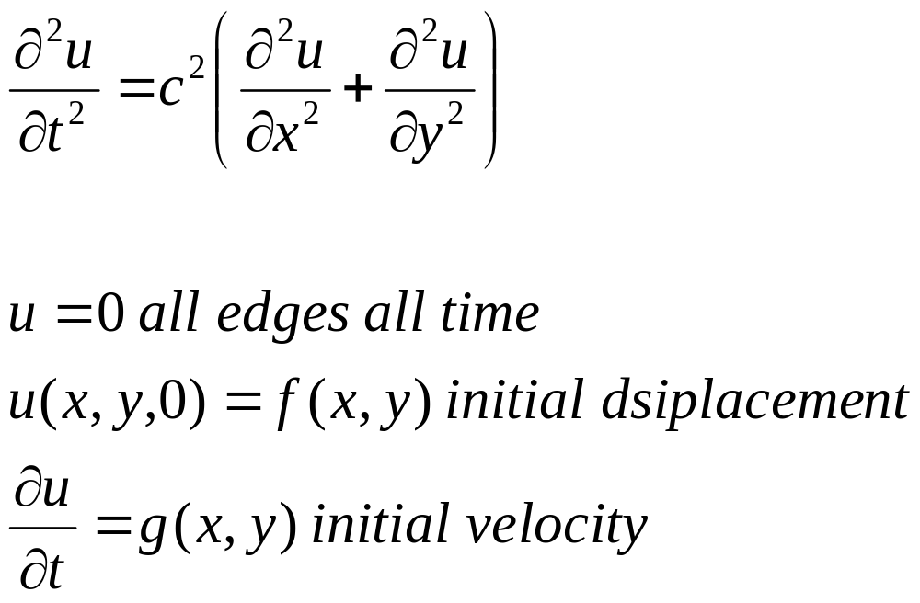
Consider two dimensional (membrane) wave equation –
Prof. P. Seshu, Mech. Engg. Dept., IIT Bombay

Slide 11
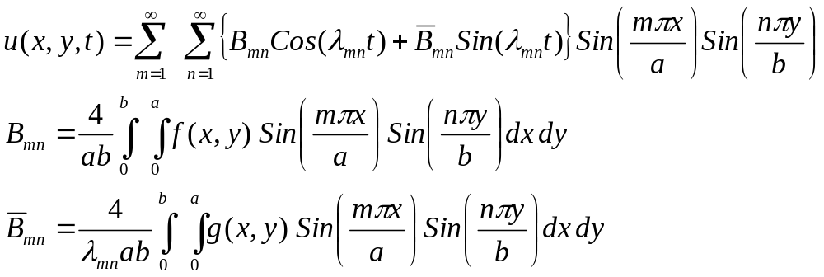
Prof. P. Seshu, Mech. Engg. Dept., IIT Bombay

Slide 12
Some Observations
Differential equations are simplified, approximate mathematical model of complex real life problems
Easy to solve exactly only for simple geometry
Solution though satisfies d.e. at every interior point and all b.c./i.c.
FEM is a tool to find approximate solutions to d.e.
Prof. P. Seshu, Mech. Engg. Dept., IIT Bombay

Slide 13
Algebraic Equations
Consider two simple equations –
5x-2y=0
4x+5y=6
We can readily solve and find that
x = 12/33 and y=30/33
Each equation represents a line and the solution is the point of intersection
Prof. P. Seshu, Mech. Engg. Dept., IIT Bombay

Slide 14
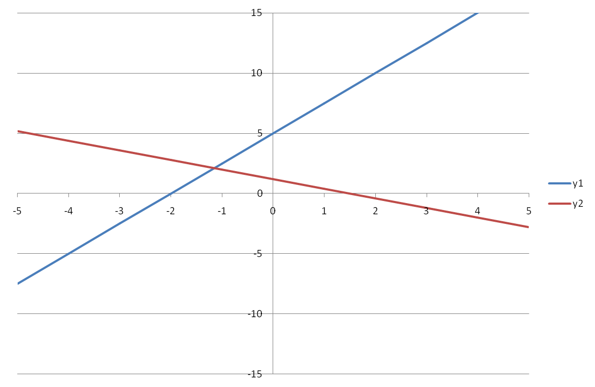
Prof. P. Seshu, Mech. Engg. Dept., IIT Bombay

Slide 15
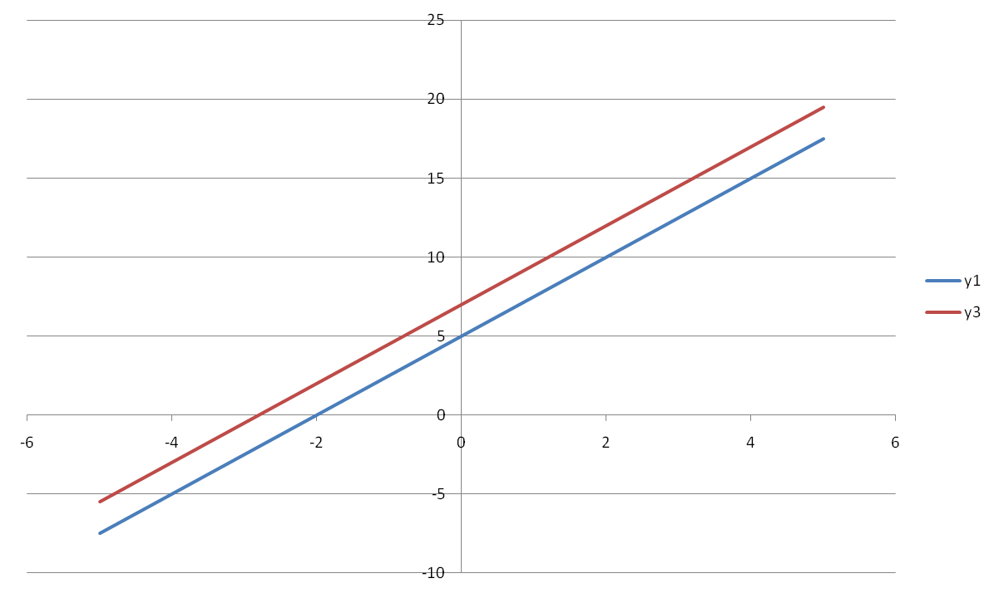
Prof. P. Seshu, Mech. Engg. Dept., IIT Bombay

Slide 16
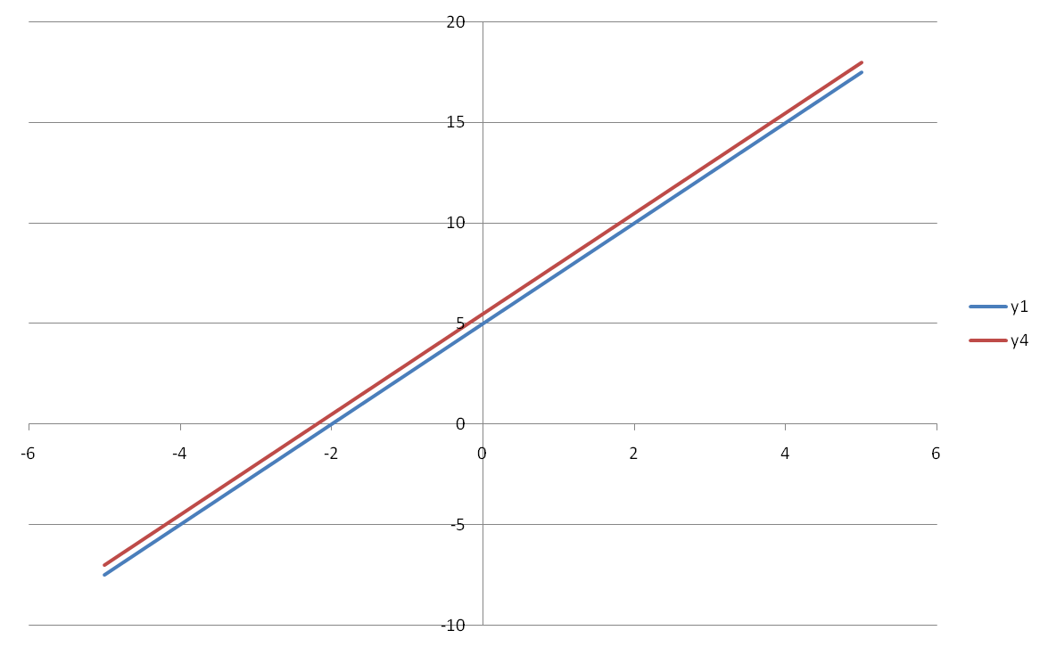
Prof. P. Seshu, Mech. Engg. Dept., IIT Bombay

Slide 17
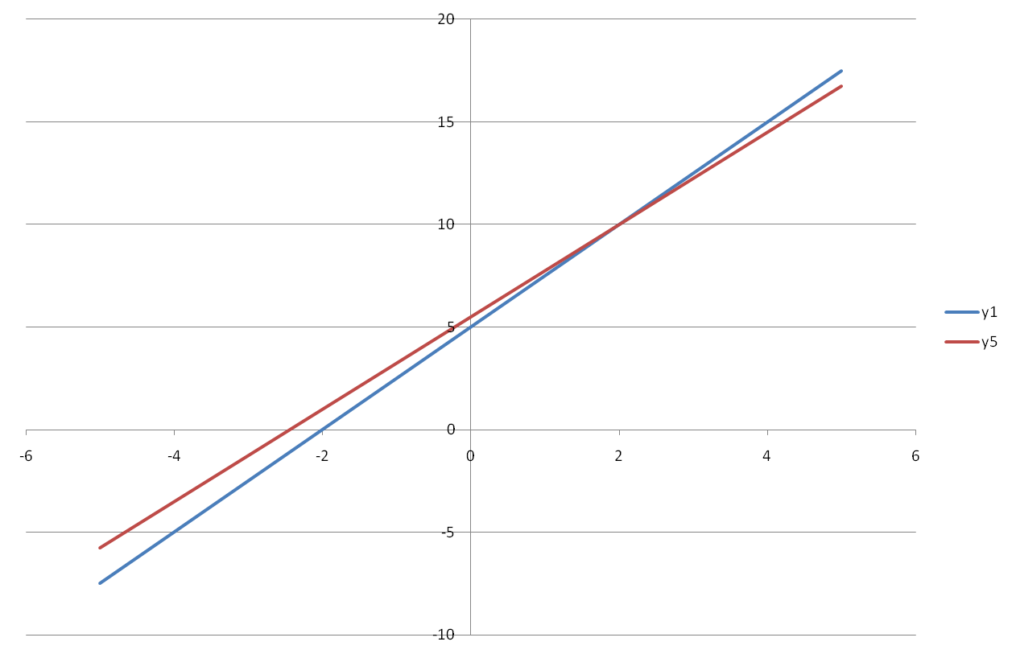
Prof. P. Seshu, Mech. Engg. Dept., IIT Bombay

Slide 18
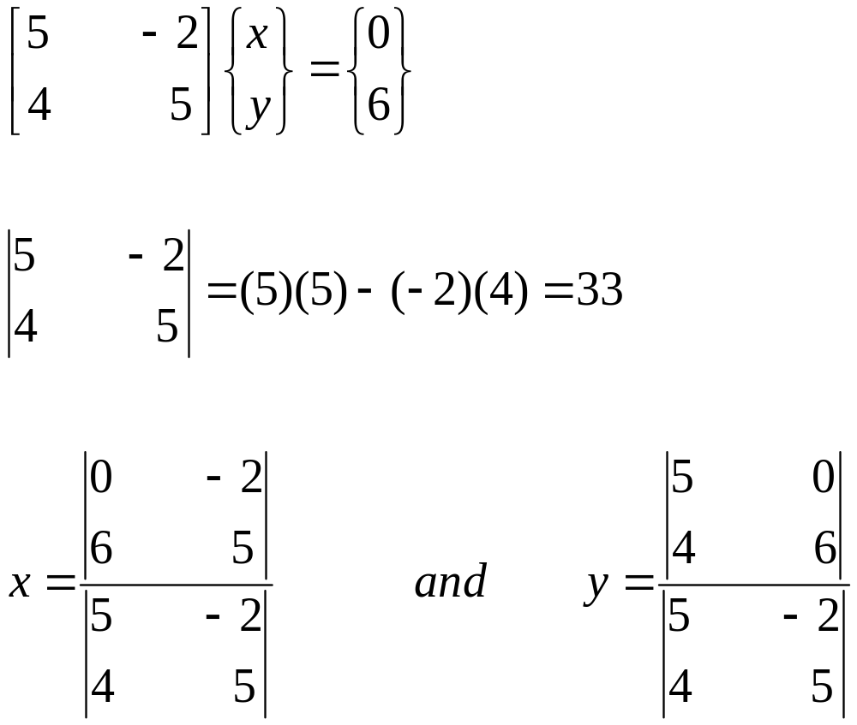
Matrix representation and Cramer’s rule
Prof. P. Seshu, Mech. Engg. Dept., IIT Bombay

Slide 19
Number of floating point operations in finding a determinant is n!
n=5, n!=120
n=10, n!=3628800
N=50, n!=3.0e64
Finite element meshes typically lead to millions of equations
Prof. P. Seshu, Mech. Engg. Dept., IIT Bombay

Slide 20
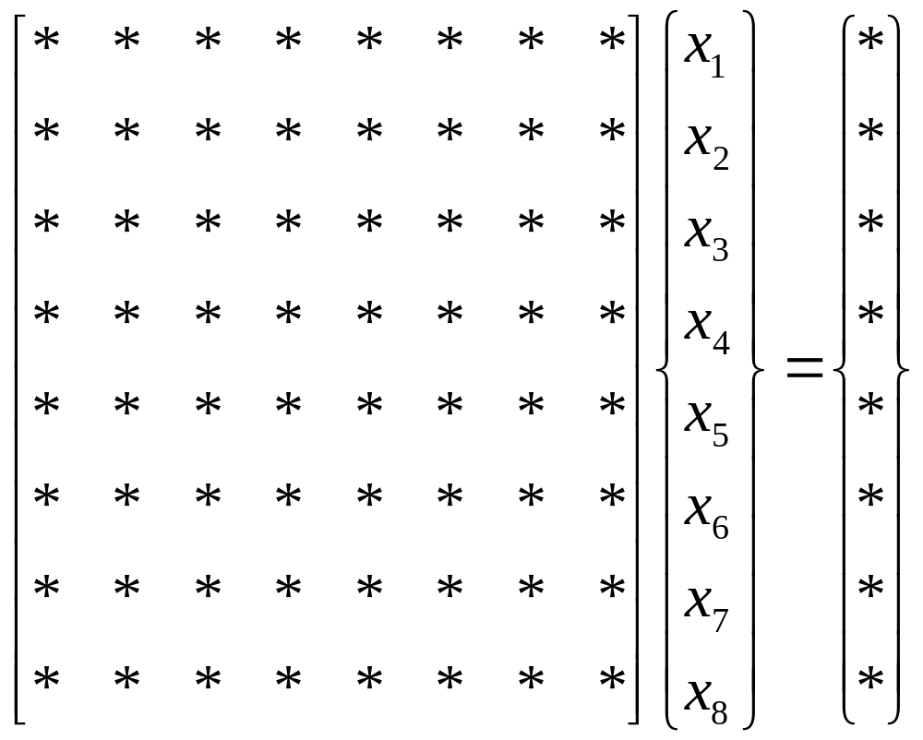
Gauss Elimination – initial stage
Prof. P. Seshu, Mech. Engg. Dept., IIT Bombay

Slide 21
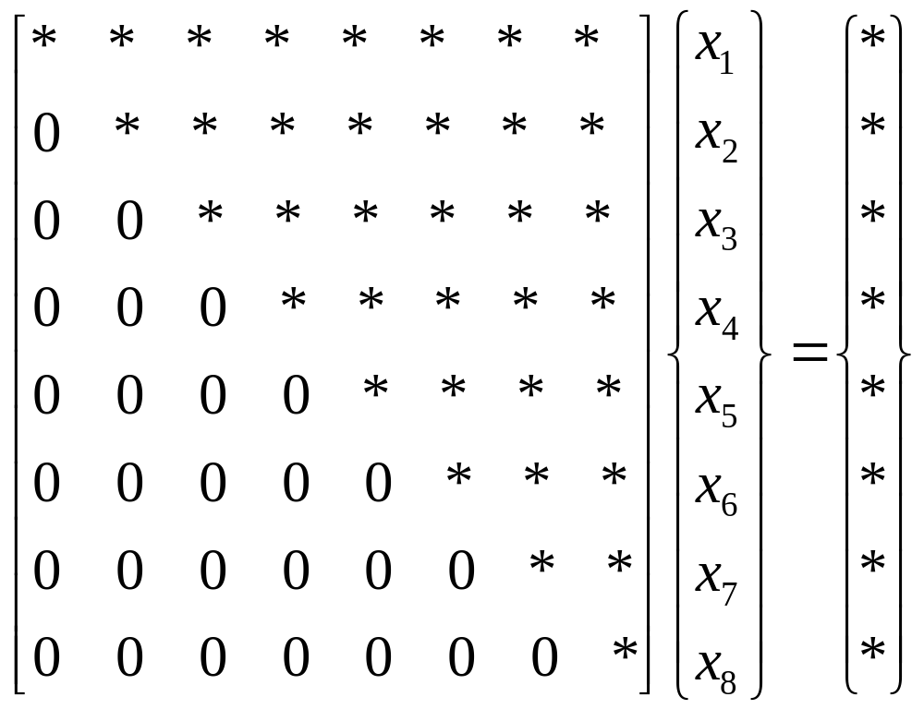
Gauss Elimination – final stage (Echelon Form)
Prof. P. Seshu, Mech. Engg. Dept., IIT Bombay

Slide 22
Interpolation
Given a set of data points, we need to find a reasonably smooth curve fit using which we can find the function value at intermediate points
Prof. P. Seshu, Mech. Engg. Dept., IIT Bombay

Slide 23
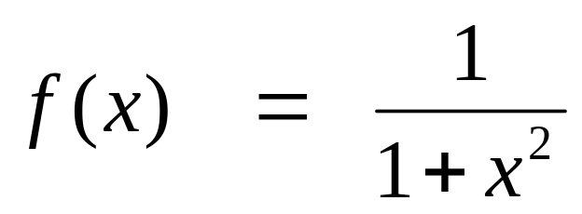
Interpolation - Illustration
Consider the function
We will use as data points, values of f(x) computed from this known expression and attempt to do curve fit
Lagrange’s interpolation is a powerful method
Prof. P. Seshu, Mech. Engg. Dept., IIT Bombay

Slide 24
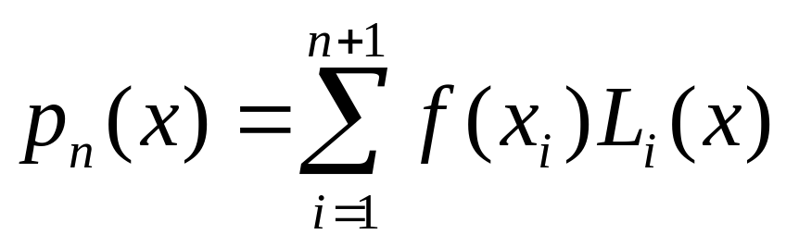
Polynomial curve fits are used because they are easy to differentiate and integrate
They can also be refined to converge to the desired accuracy
Lagrange’s formula is –
Prof. P. Seshu, Mech. Engg. Dept., IIT Bombay

Slide 25
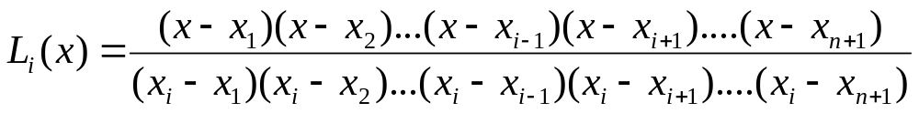
Lagrange’s polynomials are obtained as:
As an example, consider n = 2
Sampling point | Xi | F(xi)
1 | -5 | 0.038462
2 | 0 | 1
3 | 5 | 0.038462
Prof. P. Seshu, Mech. Engg. Dept., IIT Bombay

Slide 26
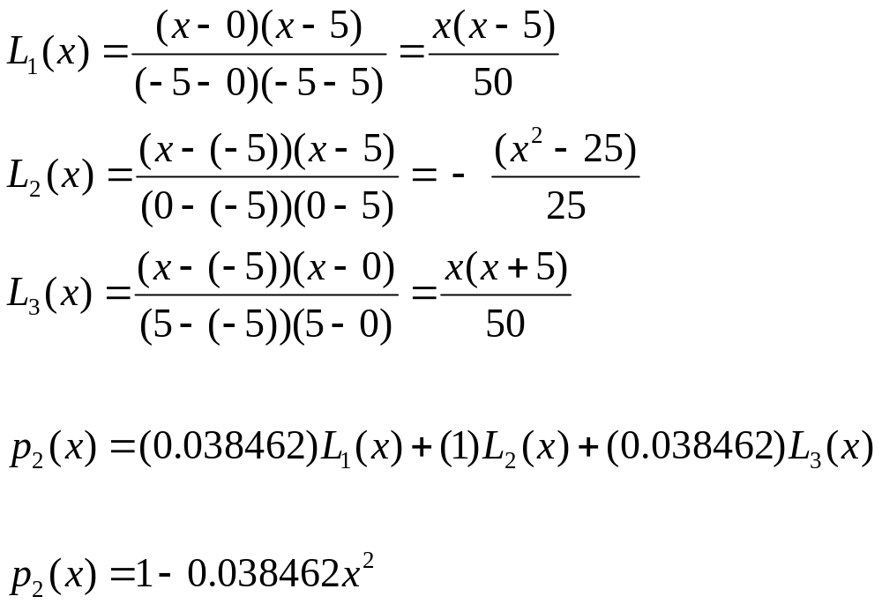
Prof. P. Seshu, Mech. Engg. Dept., IIT Bombay

Slide 27
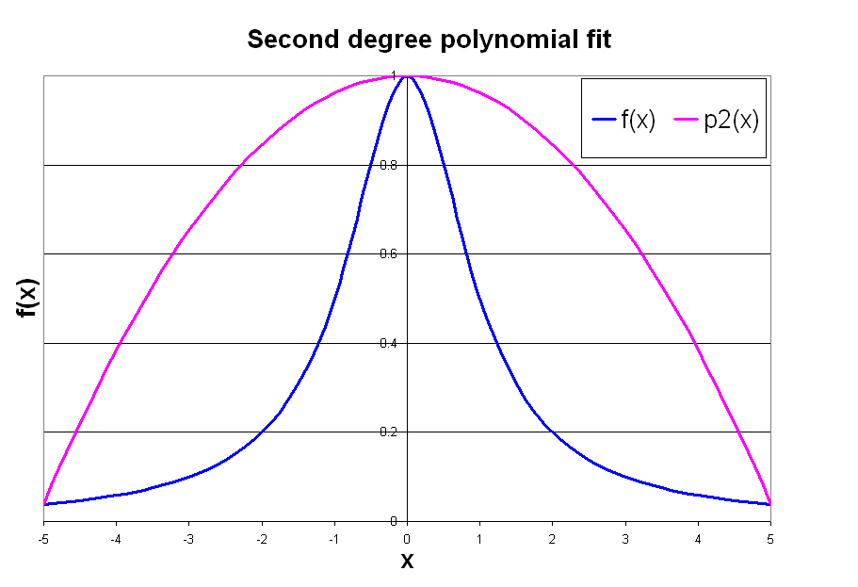
Prof. P. Seshu, Mech. Engg. Dept., IIT Bombay

Slide 28
Now consider n = 5
Sampling point | Xi | F(xi)
1 | -5 | 0.038462
2 | -3 | 0.1
3 | -1 | 0.5
4 | 1 | 0.5
5 | 3 | 0.1
6 | 5 | 0.038462
Prof. P. Seshu, Mech. Engg. Dept., IIT Bombay

Slide 29
Lagrangian polynomial fit is –
Higher degree polynomial; expected to be a better fit ??
Similarly we can take n = 10 and find polynomial fit, which will be expected to be an even better fit ????
Prof. P. Seshu, Mech. Engg. Dept., IIT Bombay

Slide 30
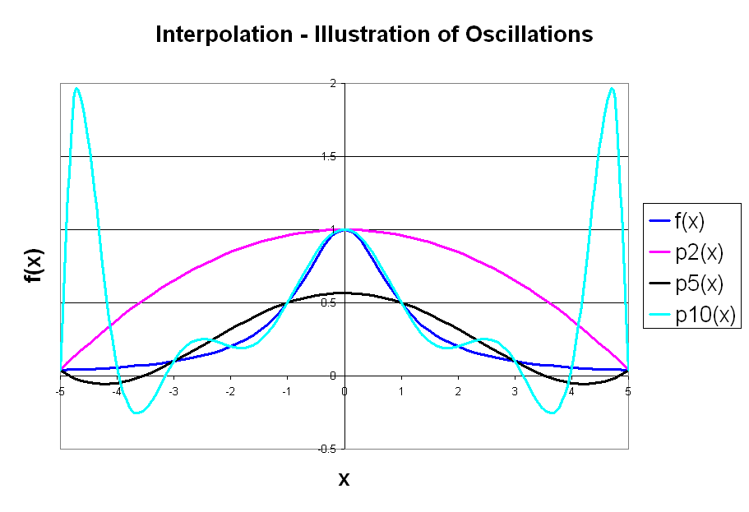
Prof. P. Seshu, Mech. Engg. Dept., IIT Bombay

Slide 31
Piecewise St Line fit
Sub-divide the whole region (-5, 5) into two or four or eight smaller regions.
Within each sub-domain, fit a straight line between the function values at the ends of the sub-domain.
The sub-divisions need not be equal size
For example, two sub-divisions could be (-5,0) and (0,5); four sub-divisions could be (-5,-3), (-3,0), (0,3) and (3,5) etc.
Prof. P. Seshu, Mech. Engg. Dept., IIT Bombay

Slide 32
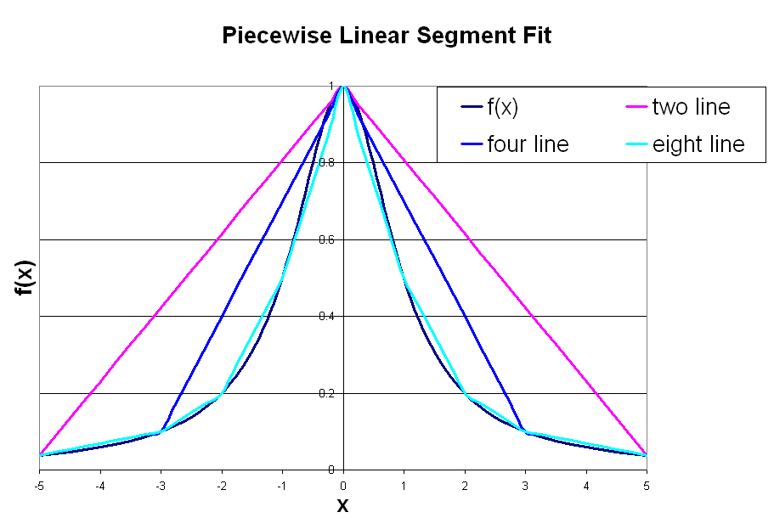
Prof. P. Seshu, Mech. Engg. Dept., IIT Bombay

